Slide 1
Airflow/AWS Demo

Slide 2
Use Case
Personal details is received in .CSV format for new joiners daily, it is required to validate the details, generate username based on first name, last name and random password. Store the details in DB and generate and send an html report after processing.
Receive .csv file
Archive .csv file
Perform Cleanup and Validation of .csv data
Upload cleaned data to AWS S3 bucket
Processing of data and persisting in DynamoDB using AWS lambda function
Read data from DynamoDB, generate report in html format and store in AWS S3 bucket.
Download html report from AWS s3 bucket to local path
Send html report over mail with html report as attachment

Slide 3
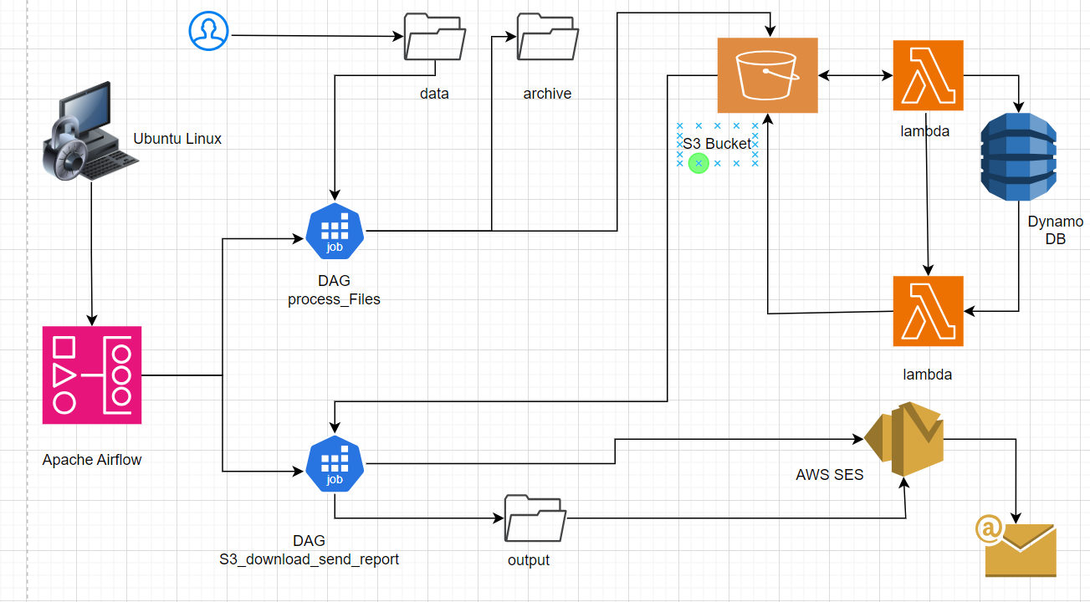
Technical Design

Slide 4
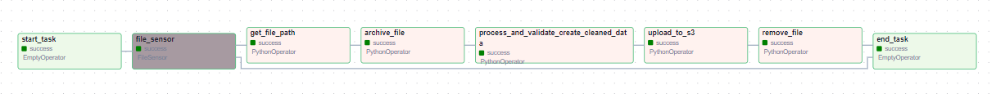
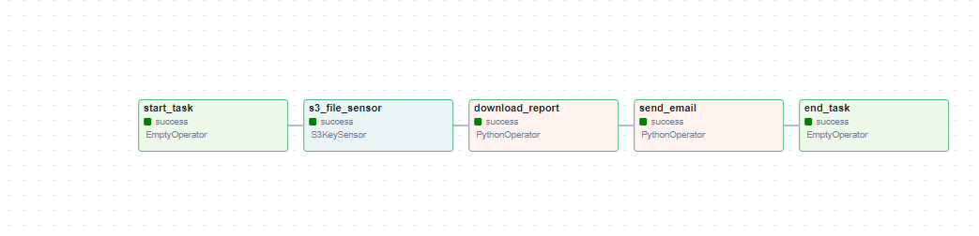
Airflow DAG

Slide 5
Airflow/AWS Implementation
Drop .csv files in local input folder (/home/airflow/data)
Airflow DAG running on Ubuntu Linux (process_files)
File sensor keeps poking input folder for the .csv
Input location /home/airflow/data
File name pattern - person_<yyyymmdd>.csv
Archive file
Name - person_<yyyymmdd_HHMMSS>.csv
Archive location - /home/airflow/archive
Validate, clean and transform data
First Name should not be null
Email should be valid
Drop any row having null in Index field
Concatenate First Name and Last Name to Name
Save valid, cleaned and transform data into output folder
Name - person_<yyyymmdd_HHMMSS>_cleaned.csv
Output location - /home/airflow/output

Slide 6
Airflow/AWS Implementation
Upload cleaned file to AWS S3 bucket
S3 bucket Name – airflowdemo
File Key – people_<yyyymmdd_HHMMSS_Cleaned.csv
Triggers lambda function (csv_s3_DynamoDB)
Process the file
Create username
Create Password
Inserts data into DynamoDB
Table Name – person
Puts a file in S3 bucket on completion for Insertion in DynamoDB
Invoke another lambda function (generate_report)
Reads Data from DynamoDB
Generate HTML report and save it to S3 bucket
S3 bucket Name – airflowdemo
File Key – output/result_<yyyyddmm>.html

Slide 7
Airflow/AWS Implementation
s3_download_send_report
Schedule: @daily info
Next Run ID: 2024-04-11, 00:00:00
Airflow DAG running on Ubuntu Linux (s3_download_send_report)
S3 File sensor keeps poking S3 bucket output folder
S3 bucket – airflowdemo
Key - s3://airflowdemo/output/result_<yyyymmdd>.html
Download the file from S3 bucket
S3 bucket – airflowdemo
File Key – output/result_<yyyymmdd>.html
Local folder - /home/report/result_<yyyymmdd>.html
Deletes the file from S3 bucket output folder after archiving
Generate and send email with downloaded local file as attachment

Slide 8
Tools & Components
Ubuntu Linux 22.04 on WSL /AWS EC2
Airflow
AWS S3
AWS lambda
DynamoDB
AWS SES (Simple Email Service)
AWS Cloudwatch

